Slide 2
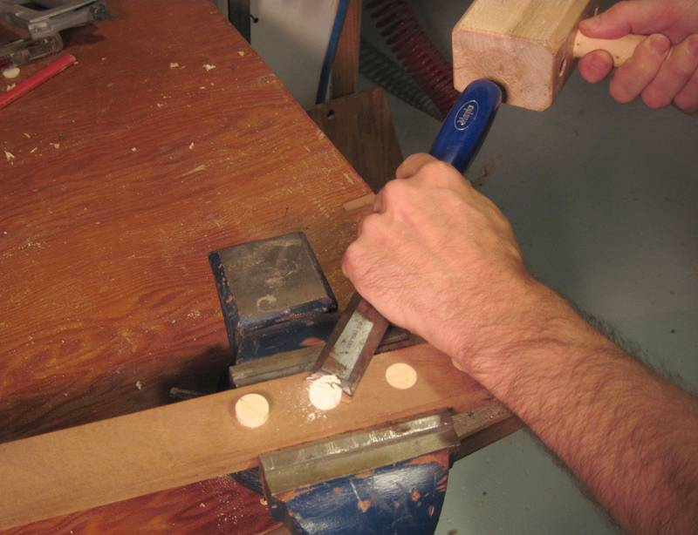
Standing Tall:
PRIDE
Matthew 23:12

Slide 3
The Product of Pride
Pride leads us to overstep boundaries
Uzziah was powerful, but he didn’t know his place (2 Chronicles 26)
Saul offered unlawfully and spared King Agag (1 Samuel 13:7-13; 15:3,9)
Pride deafens our ears to good counsel
Rehoboam rejected the advice of the elders (1 Kings 12:7-8; Proverbs 11:14)
Contrasted by Josiah (2 Kings 22:1-2; Eccl. 4:13 NLT)
Israel walked in their own counsel in Jeremiah’s day (Jeremiah 7:24; 18:11-12)

Slide 4
The Product of Pride
Pride blinds us to our own sin
Jesus rebuked the Pharisees calling them blind (Matthew 23)
Parable of the Pharisee and Tax Collector (Luke 18:9-14)
Prevents clear and effective confession (Proverbs 11:2)
Pride halts growth
The Laodiceans decided to rest on their laurels. (Revelation 3:17)
Don’t let pride deceive you (Galatians 6:3; 1 Corinthians 8:2; 1 John 1:8; Romans 12:16)

Slide 5
The Solution to Pride
Humility
Matthew 18:4; Philippians 2:3; James 4:6-10
Endurance
Philippians 3:12
God will solve our pride for us
God humbled Nebuchadnezzar (Daniel 5:20-21)
God can humble us

Slide 6
“Whoever exalts himself will be humbled, and he who humbles himself will be exalted.”
Matthew 23:12

